Slide 1

Completing the Puzzle: Lucene’s Missing Aggregation Engine
Notes:
Hi everyone! We’re on the last day of the conference and right before lunch. It’s a tough slot, so we’re going to have to make this interactive if we are to stay focused. Let me understand you a little better first. Who was at the conference in Halifax last year? Who remembers this talk about aggregations in Lucene? I was hoping to get away with reusing slides from last year.
Last year, a colleague of mine, Shradha, and I had been spending a lot of time with Lucene’s faceting in the context of an Amazon product search project. We found there were several features we wished it had and we prepared a presentation titled “Completing the puzzle: Lucene’s missing aggregation engine”. We spoke about what we would like to see from an aggregation engine in Lucene, what we had been working on and what progress we had made, and compared to other search engines.

Slide 2
Completing the Puzzle: Lucene is Still Missing an Aggregation Engine
Notes:
Today’s talk is a follow-up to that talk from last year. I thought we could check what’s happened with aggregations in Lucene in the span of a year. Those of you who have given talks, might remember that the deadline for submissions was 6 months ago. By then I had done some work in the aggregation space and thought I could talk about that. We were making progress, but there was still so much more to do. I submitted “Lucene is still missing an aggregation engine”. For the past 2 months though, I’ve been stressing over how unfortunate that title is. I no longer believe it’s true. Lucene has a new aggregation engine and it looks really promising. This new aggregation engine has gone out with Lucene 9.12 and currently lives in the sandbox module.

Slide 3


Shradha Shankar
Egor
Potemkin
Notes:
Most of the work on it up until now has been done by Egor Potemkin and Shradha Shankar, who I’m very lucky to have as colleagues. Unfortunately, neither of them got visas on time to be with us, but they’ve enlisted me to talk about this new aggregation engine. A lot of this is driven by needs that Amazon’s product search has, but we thought the right approach was to develop this in the open, and I think that has already been for the best for Lucene, for Amazon, and for the developers themselves.

Slide 4
C/C Halifax
Talk submission
Lucene 9.12
October
April
September
Notes:
Now, how am I going to resolve the title of the presentation with the situation we find ourselves in? I’m in the awkward position of having to reconcile between what I said in the talk last year, what I submitted 6 months ago, and what is true now. So here is what we’ll do. We’ll go through gaps we’d identified in Lucene’s aggregations last year and we’ll compare those three points in time: what did this look like a year ago, what does it look like without the new aggregation engine, and what does it look like if you’re using the new aggregation engine.

Slide 5
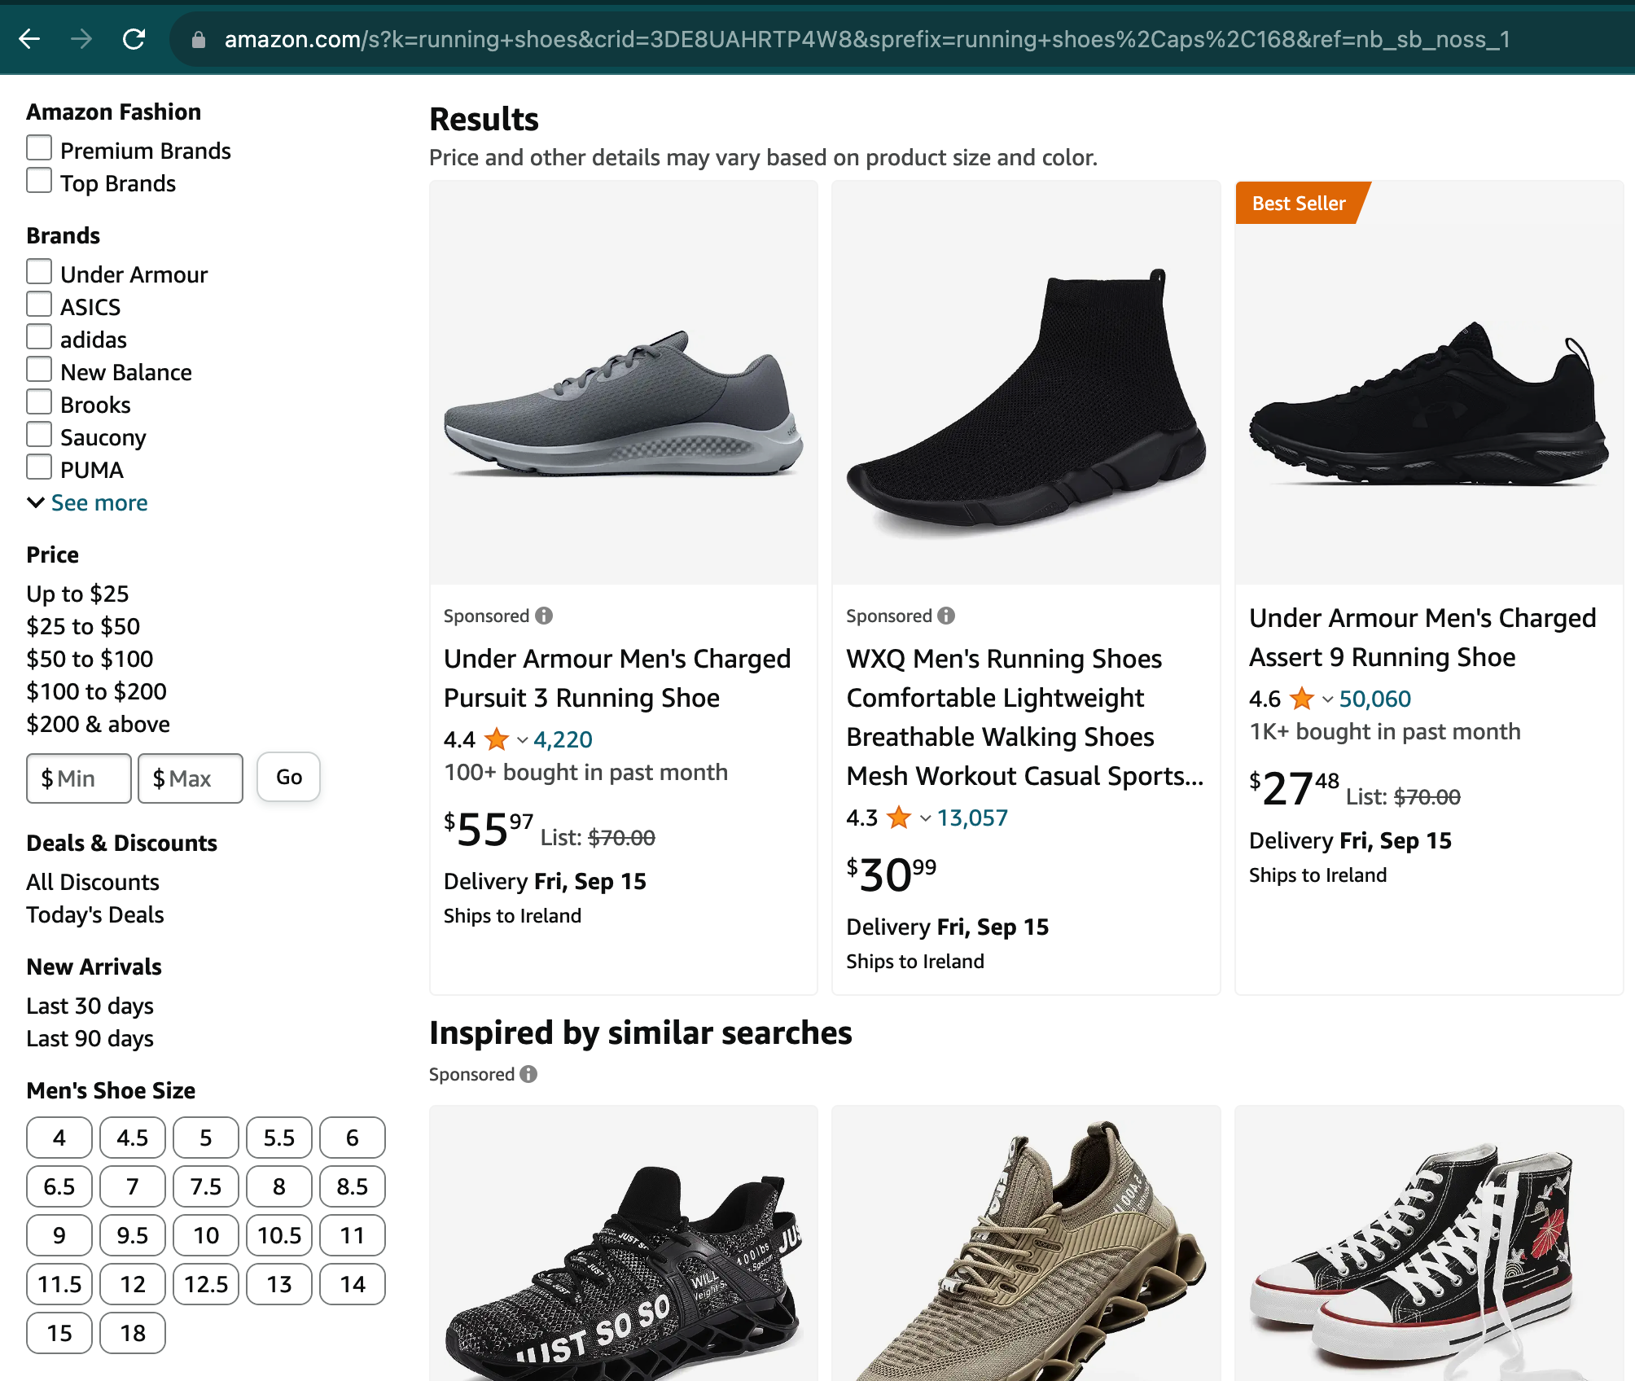
Notes:
I kept saying the words “aggregation engine” and some of you are wondering what exactly I’m talking about. I’ll illustrate. This is a search page from the Amazon retail website. Notice the filters on the left side of the page. These are backed by aggregations. For example, all the products that match the query and have brand adidas determine an aggregation group, and the aggregation in this case was a count, to make sure we’re displaying filters that will actually lead to search pages that aren’t empty. But we might want to do more interesting things. Imagine, for example that we sorted the brands in order of an average popularity score of its products. This is the sort of thing that we’ll be dealing with in this presentation. We’ll go through the different considerations in the same order as last year.

Slide 6

Dynamic
aggregation groups
Notes:
Starting with dynamic aggregation groups.

Slide 7
Charles Dickens
Romance
Author
Genre
Jules Verne
Politics
All Books
French
Digital
Language
Format
English
Paper
back
Notes:
We’ll go with books examples. An aggregation group consists of the documents over which we want to perform an aggregation. In this case, the books written by Jules Verne could be an aggregation group and books written in French could be another group.
A year ago, aggregation groups were largely determined at indexing time through facet fields. Numeric fields are an exception, you can define what ranges you want to aggregate over at query time, but we’ll talk more about them later.

Slide 8
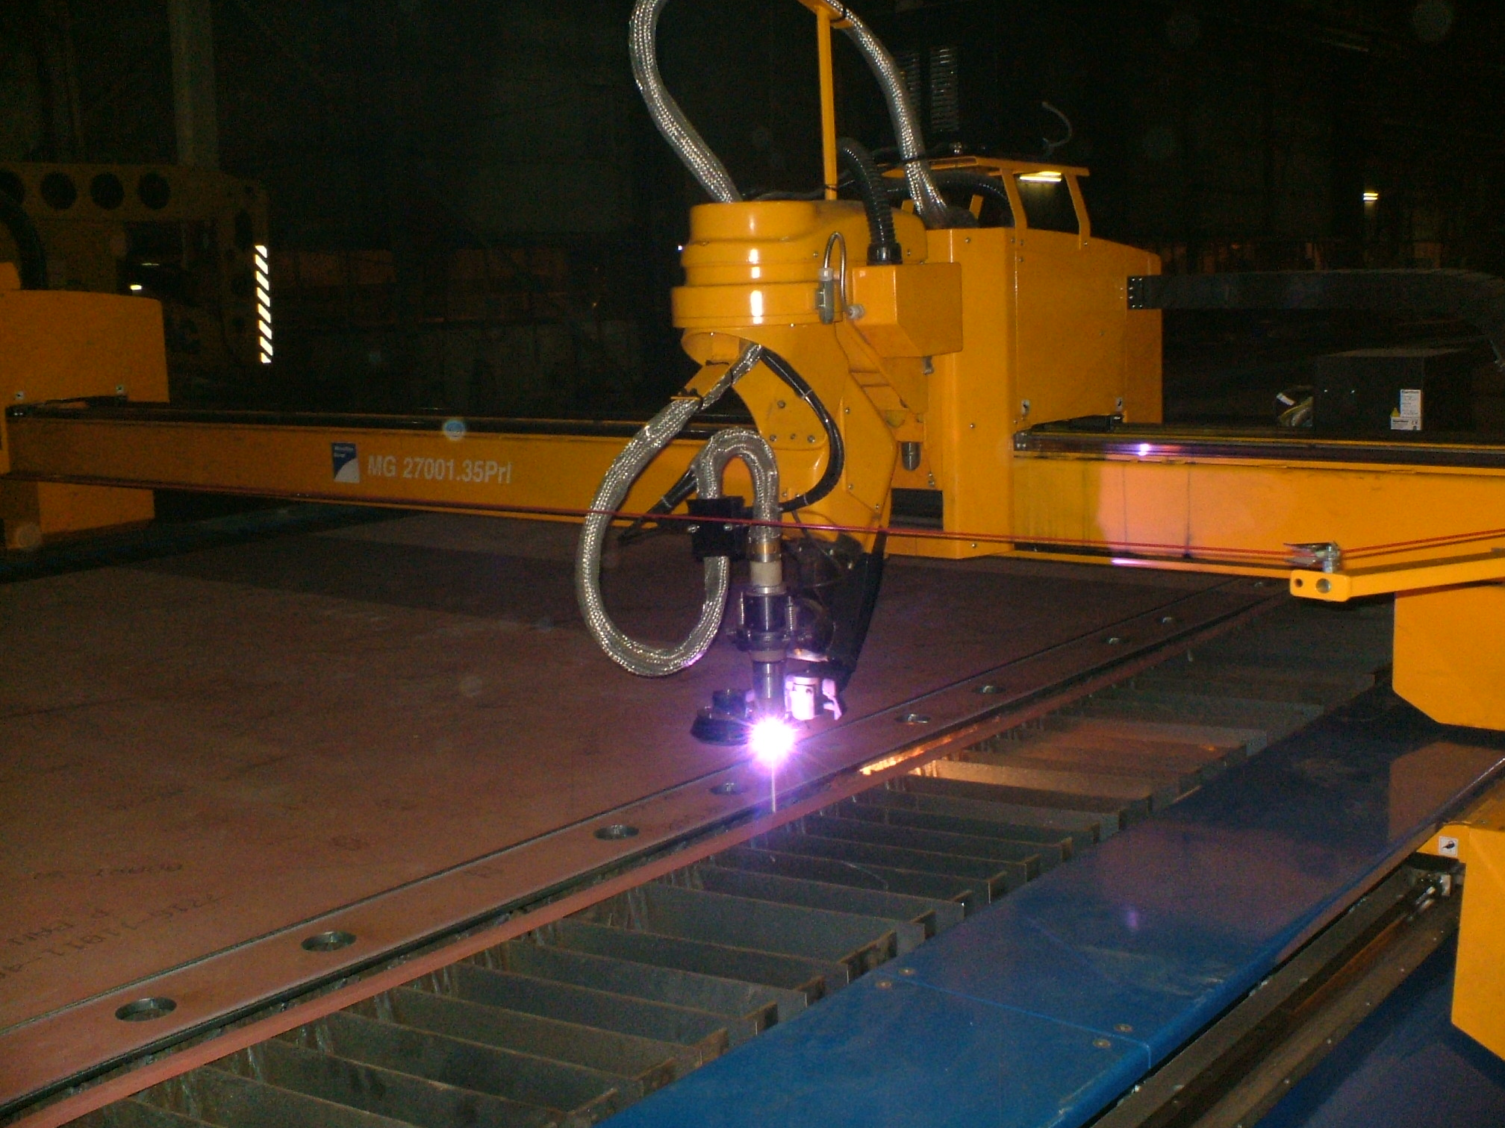
title: The Brothers Karamazov
author: Fyodor Dostoevsky
publication year: 2003
page count: 1056
sold by: Amazon
price: 12
title: The Brothers Karamazov
author: Russian
publication year: 2003
page count: 1000+
sold by: Amazon
price: 10.00-19.99
Notes:
With the new aggregation engine, we have a lot more flexibility. Let’s take a document representing a book as an example. We now have these classes called facet cutters, which, given a document, tell you which aggregation groups it belongs to, so you can assign aggregation groups to documents arbitrarily by using the right cutter. In this example, the document belongs to an aggregation group for Russian books, one for books longer than 1000 pages, and one for prices in the 10 to 19.99 range.

Slide 9


Dynamic aggregation groups
Lucene 9.11
Lucene 9.12
Notes:
Verdict: With these new cutters, you can assign a document intro arbitrary aggregation groups, which was very limited before.

Slide 10
Dynamic
aggregation groups
Defining
aggregations
Notes:
The second gap we discussed last year had to do with defining aggregations. A year ago you could do count, sum, and max, but it wasn’t very flexible if you were to extend and create a new aggregation. You would have to write your own facets implementation.

Slide 11
interface Accumulator {
accumulate (value);
reduce();
}
Notes:
To enable aggregation definitions, what we really need is to be able to define an accumulator with two operations: accumulate() and reduce(). Why do we need two? So we can implement aggregations that are not self-decomposable.

Slide 12
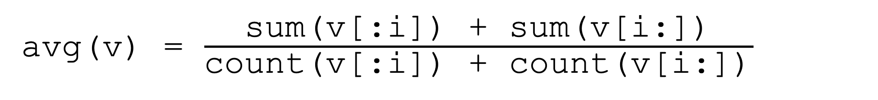
sum(v) = sum(v[:i]) + sum(v[i:])
accumulate
avg(v) = $\frac{\text{sum}\text{(}\text{v}\text{[:}\text{i}\text{]) + }\text{sum}\text{(}\text{v}\text{[}\text{i}\text{:])}}{\text{count}\text{(}\text{v}\text{[:}\text{i}\text{]) + }\text{count}\text{(}\text{v}\text{[}\text{i}\text{:])}}$
accumulate & reduce
median(v) = ...?
reduce
Notes:
Tangent: what are those? There are three classes of aggregations. In self-decomposable aggregations, results obtained over subsets of the whole dataset can be combined using the same operation to get a correct result across the entire set. For example sum. I can keep summing into an accumulator and that is how I compute the sum across the entire dataset. The second class are decomposable aggregations. Their results can be combined, but not necessarily using the same operation. For example, if we want an average, we can’t keep averaging between the accumulator and an incoming datapoint, but if we maintain a sum and a count, we can keep summing and incrementing, and do the average at the very end. Lastly we have non-decomposable aggregations. These require the entire dataset at once to be able to compute the aggregation. One example is median. You need to store all datapoints while performing the aggregations. One way to think about it is that a self-decomposable aggregation does all its computation in the accumulate call, a decomposable aggregation does work in accumulate and in reduce, and a non-decomposable aggregation does all its computation in the reduce call.

Slide 13
class Recorder implements Accumulator {
record (value); // accumulate
reduce();
}
Notes:
To come back to the main topic, defining aggregations was possible, but limited. In 9.12, we have these Recorders, which basically provide an accumulate() and a reduce(). The accumulate() operation is actually called record(); we can debate the right name.

Slide 14
Defining aggregations
Lucene 9.11
Lucene 9.12
Notes:
You can use a custom Recorder to define any aggregation you want. You might already be noticing a theme - the new aggregation engine doesn’t exactly provide the missing pieces we’re talking about, but it’s flexible enough to allow you to roll your own solution.

Slide 15
Dynamic
aggregation groups
Defining
aggregations
Multiple aggregations
Notes:
The third gap was that we couldn’t compute multiple aggregations in one iteration of the match-set. Note that the previous gap, aggregation definitions presupposes multiple aggregations. An accumulator for computing averages would really be computing a sum and a count.

Slide 16
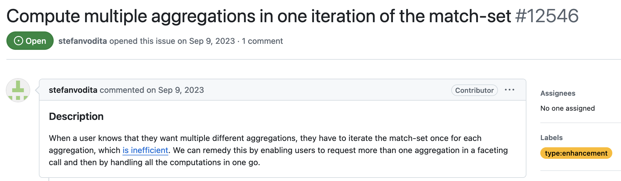
Notes:
I actually had a PR with associated benchmark results last year and I never merged it because I wanted to resolve another issue first. The way faceting had evolved in Lucene led to a lot of code duplication, so I refactored all the taxonomy facets code to make it more generic, but still have to go back and rebase the multiple aggregations PR. We do have 2 aggregations in one iteration in the taxonmy facets after that refactoring because counts will always be computed and you can additionally compute a sum or max. Side-note: I’m really unhappy with the way LabelAndValue works now and I’d be thrilled to hear ideas on how we can make it better.

Slide 17
Match
Facet
Match & Facet
Notes:
In the new aggregation engine, the question of multiple aggregations is a little different because we collect data for the aggregations at match-time. We no longer do iterations of the match-set after collecting it to compute the aggregations. I would say that multiple aggregations are supported, but recognise that it means something slightly different than we had in mind last year.

Slide 18
-44% p99 latency
+15% throughput
Notes:
This is also a good time to note the performance improvements from this new aggregation engine, which are significant. Unfortunately, we don’t yet have performance tests in luceneutil, which is the open source Lucene benchmarks repo, but I can tell you that on Amazon workloads, we saw the new aggregation engine improve query throughput 15% and reduce p99 query latency 44%. Here I want to commend again Egor and Shradha, because that’s a really impressive achievement. The throughput improvement in our case came from being able to reuse DocValues that would have been recomputed in the faceting phase before across every Facets instance, and the latency improvement comes from the parallelism we have in the matching phase, which we didn’t have in faceting.

Slide 19
Multiple aggregations
Lucene 9.11
Lucene 9.12
Notes:
Verdict: We have multiple aggregations in 9.12. It’s not in the way I expected it, but it’s there nonetheless.

Slide 20
Dynamic
aggregation groups
Defining
aggregations
Multiple aggregations
Aggregation
expressions
Notes:
Aggregation expressions. This is an interesting one.

Slide 21
Aggregating over an expression: max(log(2 * page_count / popularity + 42))
Arithmetic over aggregations: 2 * log(max(page_count) / sum(popularity)) + 42
Notes:
We want to compute expressions where aggregations are terms in the expression. That is, the second example here, where aggregations are terms in an expression. We had code for this even a year ago, but we never made progress on it. In particular, we wanted a well-thought out language for defining these expressions. In the new aggregation engine, the gap to provide this functionality has narrowed. I’d really welcome a design discussion on this. The way I imagine it working is that we have an expression language and a parser that is able to produce the right recorders for each term in the expression and then a recorder to wrap them all and reduce them to get the final result.

Slide 22
Aggregation expressions
Lucene 9.11
Lucene 9.12
Notes:
Overall, I’ll say this is not supported, because it really needs more work to make it convenient to use.

Slide 23
Dynamic
aggregation groups
Defining
aggregations
Multiple aggregations
Aggregation
expressions
Flexible aggregation targets
Notes:
Flexible aggregation targets.

Slide 24
Russian
British
Dostoevsky
Tolstoy
Tolkien
Lewis
The Brothers
Karamazov
The Idiot
War and Peace
The
Silmarillion
The Lord of
the Rings
The Screwtape Letters
Notes:
Let’s look at this example. At the bottom we have the documents, which stand in for books. And we have facets for the authors of the books and their nationalities, structured hierarchically. If I want counts here, Lucene will compute counts across this entire hierarchy, but what if I only care about Dostoevsky and British? Can’t I only compute counts for them and be more efficient? Not really actually. The new aggregation engine implemented a Cutter for this purpose, but it got removed at some point because it wasn’t really showing any improvement. If you think it would be useful in your case, you can always roll your own.

Slide 25
Flexible aggregation targets
Lucene 9.11
Lucene 9.12
Notes:
I’m giving 9.12 a checkmark because you can technically do this if you want to, but it doesn’t really seem worth it.

Slide 26
Dynamic
aggregation groups
Defining
aggregations
Multiple aggregations
Aggregation
expressions
Flexible aggregation targets
Nested aggregations
Notes:
Nested aggregations, a tricky one.

Slide 27
max(count() for book in author) for author in nationality
13
40
Russian
British
13
6
29
40
Dostoevsky
Tolstoy
Tolkien
Lewis
Notes:
This is the same example as before, I’ve just removed the bottom layer for simplicity. Let’s say I want to know the nationality of the author who’s written the most books, i.e. max per nationality of count per author. You couldn’t really do this without the new aggregation engine and I’m not sure you could do it with the new aggregation engine either. You definitely need two recorders, one for each aggregation we’re computing. And you definitely need a cutter to determine per-author aggregation groups. To then have the results of those aggregations participate in the computation at the level above, you’d probably need to augment the way these results roll up. It’s tricky and needs someone to think hard about the problem - maybe that could be you!

Slide 28
Nested aggregations
Lucene 9.11
Lucene 9.12
Notes:
For now, I’ll say this can’t be done, because it still seems quite far away.

Slide 29
Dynamic
aggregation groups
Defining
aggregations
Multiple aggregations
Aggregation
expressions
Flexible aggregation targets
Nested aggregations
Data about aggregation groups
Notes:
The last one has to do with storing data about aggregation groups.

Slide 30
Dostoevsky
Tolkien
Title: The Brothers
Karamazov Page Count: 880
Popularity: 85
Title: The Idiot Page Count: 498
Popularity: 85
Title: The
Silmarillion Page Count: 432 Popularity: 92
Title: The Lord of
the Rings Page Count: 1248 Popularity: 92
Notes:
Building off the previous example, if an author has a popularity score, where do we store that? Storing it on every document that mentions the author is inefficient and it allows for inconsistencies. Ideally, we could store data about an aggregation group, like author, once, in a centralised fashion.

Slide 31
Parent: -1
Full Path:
Parent: 0
Full Path: Author
Parent: 1
Full Path: Author/Dostoevsky
Parent: 1
Full Path: Author/Tolkien
Notes:
Facets can be modeled using a side-car taxonomy index. In it, each document corresponds to an instance of a facet. In this case, we have a doc for the Author dimension, one for Dostoevsky, and one for Tolkien.

Slide 32
Parent: -1
Full Path:
Parent: 0
Full Path: Author
Parent: 1
Full Path: Author/Dostoevsky
Popularity: 85
Parent: 1
Full Path: Author/Tolkien
Popularity: 92
Notes:
We’ve augmented the taxonomy to index arbitrary data with each of these documents. So we can store a popularity score for each author.

Slide 33
Data about aggregation groups
Lucene 9.11
Lucene 9.12
Notes:
I think I merged this back in March, so we actually have it in 9.11 as well, but it also works with the new aggregation engine. There’s more work we can do to make this convenient to use thought.

Slide 34
Notes:
Those of you who are impatient for lunch and are checking the time would have noticed we still have a few minutes. Enough to talk about a few concerns which hadn’t come up last year.

Slide 35
Dynamic numeric ranges
Notes:
Remember how I said we’d come back to ranges?

Slide 36
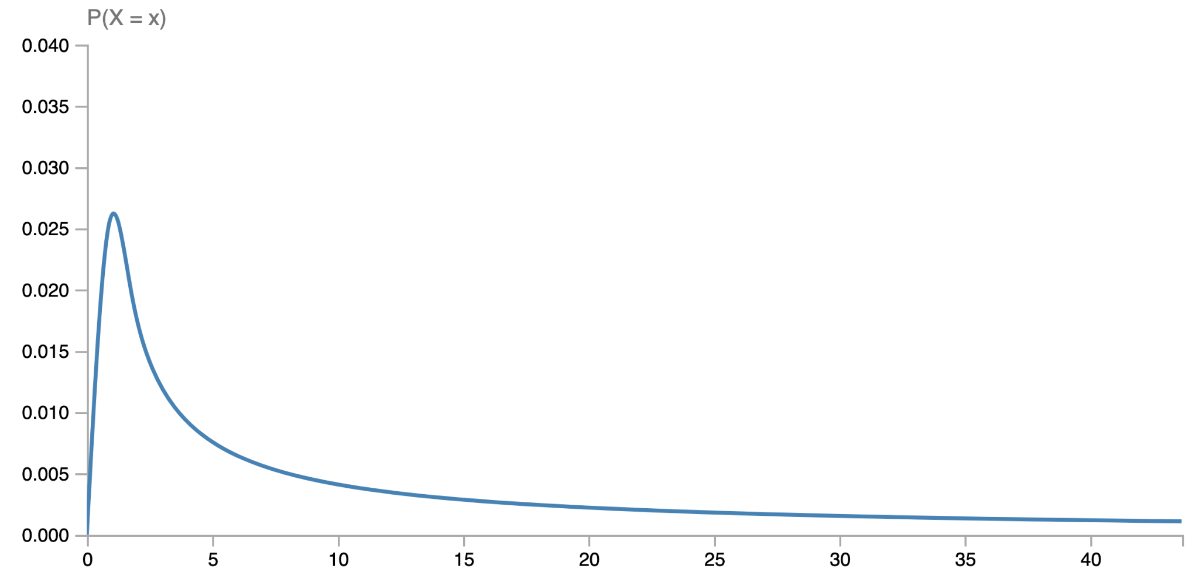
count
40
35
30
25
20
15
10
5
0
price
Notes:
Let’s say we want to allow users to filter books by price. We can’t simply list numbers, we have to show ranges. How do we come up with those ranges? One answer is to have some static ranges. These aren’t very good though. Almost everything is in the yellow range and almost nothing is in the blue one. You’ll say you can adjust them to make them better, but will that hold for all queries? Will it hold when the underlying data changes?
Pinned distribution Lognormal: u=8; s=7

Slide 37
count
40
35
30
25
20
15
10
5
0
price
Notes:
The alternative is to have dynamic ranges. With dynamic range facets, we collect all the page counts for the match-set and build ranges over them. The user only specifies how many ranges they want, and then Lucene can return ranges that have roughly equal numbers of matches in them.
Pinned distribution Lognormal: u=8; s=7

Slide 38


Yuting Gan
Greg
Miller
Notes:
I have to give credit here to my colleagues, Greg and Yuting, for thinking this up and doing most of the work to develop this feature for Amazon product search. My contribution is mostly just in bringing it to open source.

Slide 39
Dynamic numeric ranges
Lucene 9.11
Lucene 9.12
Notes:
This is actually not part of the new aggregation engine, it just happened to be released in 9.12 as well.

Slide 40
Accurate float aggregations
Notes:
This is a pet peeve of mine.

Slide 41

a + (b + c) != (a + b) + c
Notes:
Float summation is not associative, so float aggregations tend to produce significant errors. We’ve run into this a few times already, this is the most recent example. We haven’t really addressed this other than changing our tests to match the expectation for significant inaccuracies. A solution would be to implement a compensated summation algorithm for floats, such as Kahan summation. We would need to maintain a sum and an error as we’re performing the aggregation.

Slide 42
Accurate float aggregations
Lucene 9.11
Lucene 9.12
Notes:
Last year this would have been hard because there was no explicit accumulator structure. Now, this is doable with a recorder that maintains a sum and error, but it’s not done yet.

Slide 43
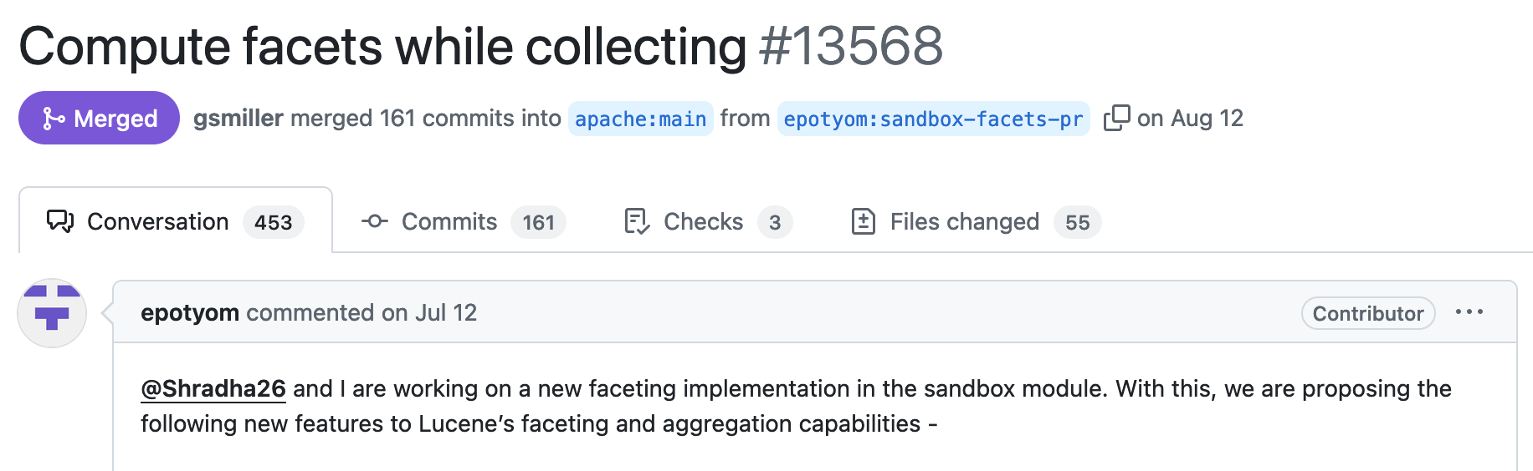

What should we name Lucene’s new aggregation engine?
Slido.com -> 2833531
Images sourced from Wikimedia (CC BY-SA 3.0+), Amazon, and me
Notes:
Conclusion! If any of that peaked your curiosity, please have a look at this new aggregation engine. See if it can be useful to you, either because of the improved performance or because the increased flexibility will allow you to do new things. There is a lot of work to do in support of some of the missing pieces we’ve been discussing, around making default use-cases easy, around replicating functionality that already exists in Lucene faceting, and around building benchmarking support. So much has happened in Lucene’s aggregations in just one year!
One last fun thing I want to do is name the new aggregation engine. If I have to keep saying new aggregation engine, that will get a bit annoying. In the spirit of open source, let’s crowd-source a name. Scan this QR code or got to slido.com and enter the number here. Make a suggestion there and vote on others’ suggestions. While you do that, I’ll take questions.

Slide 44
https://en.wikipedia.org/wiki/File:Cnc_plasma_cutting2.jpg
https://commons.wikimedia.org/wiki/File:Eo_circle_green_checkmark.svg
https://commons.wikimedia.org/wiki/File:Traffic_Sign_GR_-_Old_-_No_Entry.svg

